Slide 1
Software process model
Process models prescribe a distinct set of activities, actions, tasks, milestones, and work products required to engineer high quality software.
Process models are not perfect, but provide roadmap for software engineering work.
Software models provide stability, control, and organization to a process that if not managed can easily get out of control
Software process models are adapted to meet the needs of software engineers and managers for a specific project.

Slide 2
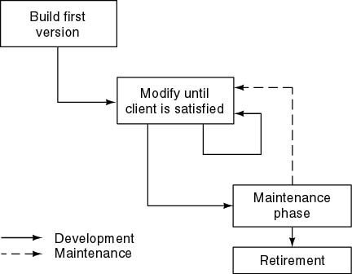
Build and Fix Model

Slide 3
Build and Fix Model
The earlier approach
Product is constructed without specification or any attempt at design.
developers simply build a product that is reworked as many times as necessary to satisfy the client.
model may work for small projects but is totally unsatisfactory for products of any reasonable size.
Maintenance is high.
Source of difficulties and deficiencies
  impossible to predict
  impossible to manage

Slide 4
Why Models are needed?
Symptoms of inadequacy: the software crisis
  scheduled time and cost exceeded
  user expectations not met
  poor quality

Slide 5
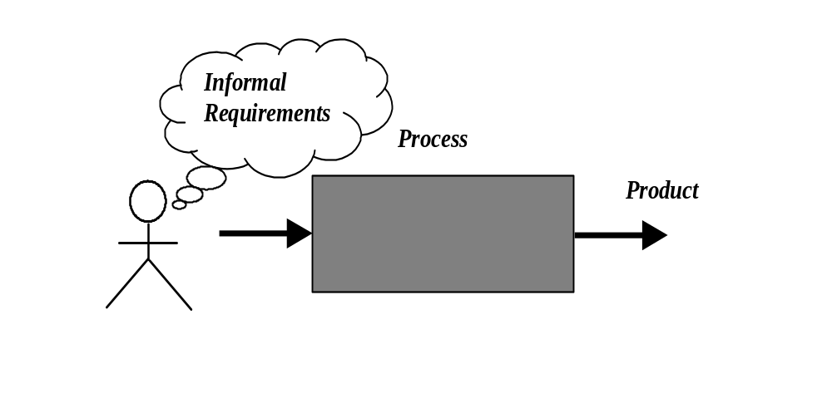
Process as a "black box"
Quality?
Uncertain /
Incomplete requirement
In the beginning

Slide 6
Problems
The assumption is that requirements can be fully understood prior to development
Interaction with the customer occurs only at the beginning (requirements) and end (after delivery)
Unfortunately the assumption almost never holds

Slide 7
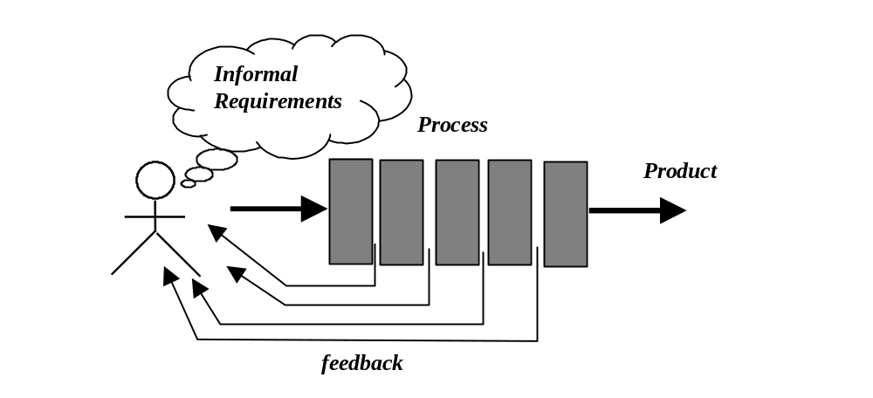
Process as a "white box"

Slide 8
Advantages
Reduce risks by improving visibility
Allow project changes as the project progresses
  based on feedback from the customer

Slide 9
Prescriptive Model
An orderly approach to software engineering
  Organize framework activities in a certain order
Each action in terms of a task set that identifies the work to be accomplished to meet the goals.
The resultant process model should be adapted to accommodate the nature of the specific project, people doing the work, and the work environment.
Software engineer choose process framework that includes activities like;
  Communication
  Planning
  Modeling
  Construction
  Deployment

Slide 10
Prescriptive Model
Calling this model as “Prescribe” because it recommend a set of process elements, activities, action task, work product & quality.
Each elements are inter related to one another (called workflow).

Slide 11
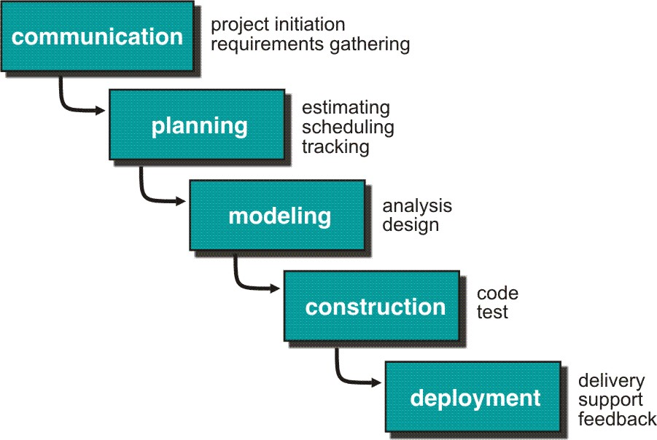
Waterfall Model or Classic Life Cycle

Slide 12
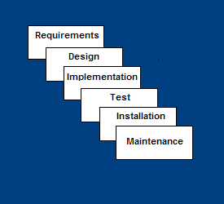
Waterfall Model
Requirements – defines needed information, function, behavior, performance and interfaces.
Design – data structures, software architecture, interface representations, algorithmic details.
Implementation – source code, database, user documentation, testing.

Slide 13
Waterfall Strengths
Easy to understand, easy to use
Provides structure to inexperienced staff
Milestones are well understood
Sets requirements stability
Good for management control (plan, staff, track)
Works well when quality is more important than cost or schedule

Slide 14
Waterfall Deficiencies
All requirements must be known upfront
Deliverables created for each phase are considered frozen – inhibits flexibility
Can give a false impression of progress
Does not reflect problem-solving nature of software development – iterations of phases
Integration is one big bang at the end
Little opportunity for customer to preview the system (until it may be too late)

Slide 15
When to use the Waterfall Model
Requirements are very well known
Product definition is stable
Technology is understood
New version of an existing product
Porting an existing product to a new platform.

Slide 16

The V-Model
A variation of waterfall model depicts the relationship of quality assurance actions to the actions associated with communication, modeling and early code construction activates.
Team first moves down the left side of the V to refine the problem requirements. Once code is generated, the team moves up the right side of the V, performing a series of tests that validate each of the models created as the team moved down the left side.

Slide 17
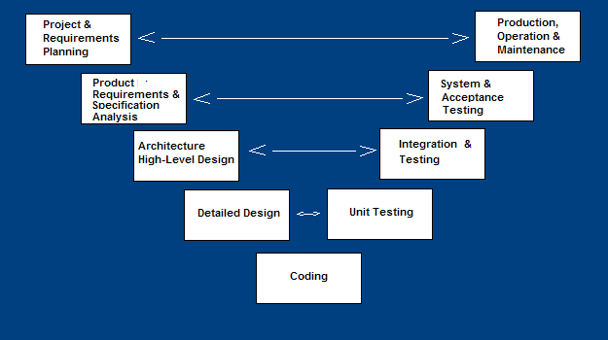
V-Shaped SDLC Model
A variant of the Waterfall that emphasizes the verification and validation of the product.
Testing of the product is planned in parallel with a corresponding phase of development

Slide 18
V-Shaped Steps
Project and Requirements Planning – allocate resources
Product Requirements and Specification Analysis – complete specification of the software system
Architecture or High-Level Design – defines how software functions fulfill the design
Detailed Design – develop algorithms for each architectural component
Production, operation and maintenance – provide for enhancement and corrections
System and acceptance testing – check the entire software system in its environment
Integration and Testing – check that modules interconnect correctly
Unit testing – check that each module acts as expected
Coding – transform algorithms into software

Slide 19
V-Shaped Strengths
Emphasize planning for verification and validation of the product in early stages of product development
Each deliverable must be testable
Project management can track progress by milestones
Easy to use

Slide 20
V-Shaped Weaknesses
Does not easily handle concurrent events
Does not handle iterations or phases
Does not easily handle dynamic changes in requirements
Does not contain risk analysis activities

Slide 21
When to use the V-Shaped Model
Excellent choice for systems requiring high reliability – hospital patient control applications
All requirements are known up-front
When it can be modified to handle changing requirements beyond analysis phase
Solution and technology are known

Slide 22
Structured Evolutionary Prototyping Model
Developers build a prototype during the requirements phase
Prototype is evaluated by end users
Users give corrective feedback
Developers further refine the prototype
When the user is satisfied, the prototype code is brought up to the standards needed for a final product.

Slide 23
Evolutionary Process Model
Produce an increasingly more complete version of the software with each iteration.
Evolutionary Models are iterative.
Evolutionary models are:
  Prototyping
  Spiral Model
  Concurrent Development Model
  Fourth Generation Techniques (4GT)

Slide 24
Evolutionary development
Exploratory development
  Objective is to work with customers and to evolve a final system from an initial outline specification. Should start with well-understood requirements and add new features as proposed by the customer.
Throw-away prototyping
  Objective is to understand the system requirements. Should start with poorly understood requirements to clarify what is really needed.

Slide 25
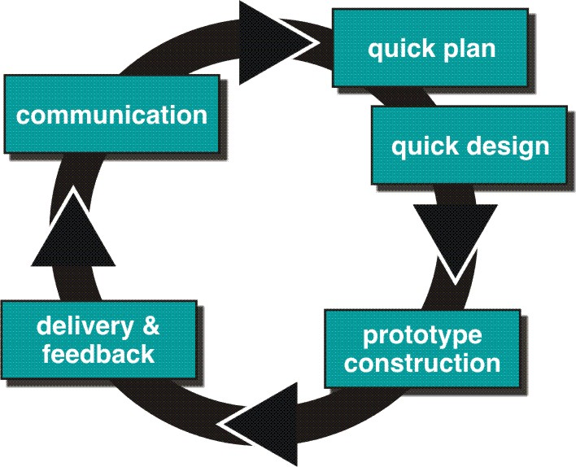
Evolutionary Process Models : Prototyping

Slide 26
Structured Evolutionary Prototyping Steps
A preliminary project plan is developed
An partial high-level paper model is created
The model is source for a partial requirements specification
A prototype is built with basic and critical attributes
The designer builds
  the database
  user interface
  algorithmic functions
The designer demonstrates the prototype, the user evaluates for problems and suggests improvements.
This loop continues until the user is satisfied

Slide 27
Prototyping cohesive
Best approach when:
  Objectives defines by customer are general but does not have details like input, processing, or output requirement.
  Developer may be unsure of the efficiency of an algorithm, O.S., or the form that human machine interaction should take.
It can be used as standalone process model.
Model assist software engineer and customer to better understand what is to be built when requirement are fuzzy.
Prototyping start with communication, between a customer and software engineer to define overall objective, identify requirements and make a boundary.
Going ahead, planned quickly and modeling (software layout visible to the customers/end-user) occurs.
Quick design leads to prototype construction.
Prototype is deployed and evaluated by the customer/user.
Feedback from customer/end user will refine requirement and that is how iteration occurs during prototype to satisfy the needs of the customer.

Slide 28
Prototyping (cont..)
Prototype can be serve as “the first system”.
Both customers and developers like the prototyping paradigm.
  Customer/End user gets a feel for the actual system
  Developer get to build something immediately.
Customer and developer both must be agree that the prototype is built to serve as a mechanism for defining requirement.

Slide 29
Structured Evolutionary Prototyping Strengths
Customers can “see” the system requirements as they are being gathered
Developers learn from customers
A more accurate end product
Unexpected requirements accommodated
Allows for flexible design and development
Steady, visible signs of progress produced
Interaction with the prototype stimulates awareness of additional needed functionality

Slide 30
Structured Evolutionary Prototyping Weaknesses
Tendency to abandon structured program development for “code-and-fix” development
Bad reputation for “quick-and-dirty” methods
Overall maintainability may be overlooked
The customer may want the prototype delivered.
Process may continue forever (scope creep)

Slide 31
When to use
Structured Evolutionary Prototyping
Requirements are unstable or have to be clarified
As the requirements clarification stage of a waterfall model
Develop user interfaces
Short-lived demonstrations
New, original development
With the analysis and design portions of object-oriented development.

Slide 32
Three Concerns on Evolutionary Processes
First concern is that prototyping poses a problem to project planning because of the uncertain number of cycles required to construct the product.
Second, it does not establish the maximum speed of the evolution. If the evolution occur too fast, without a period of relaxation, it is certain that the process will fall into chaos. On the other hand if the speed is too slow then productivity could be affected.
Third, software processes should be focused on flexibility and extensibility rather than on high quality. We should prioritize the speed of the development over zero defects. Extending the development in order to reach high quality could result in a late delivery of the product when the opportunity niche has disappeared.

Slide 33
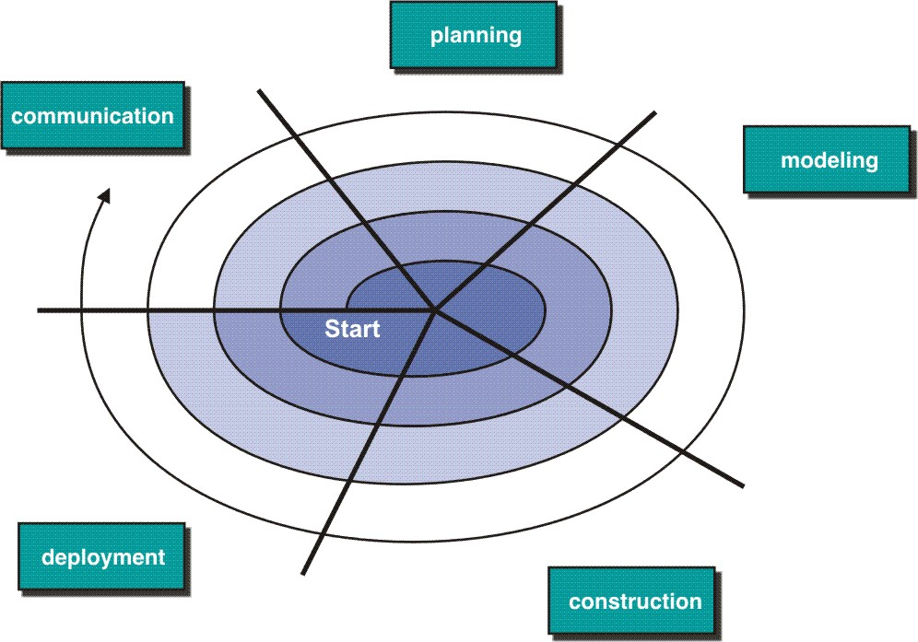
Evolutionary Model: Spiral Model

Slide 34
Spiral Model
Couples iterative nature of prototyping with the controlled and systematic aspects of the linear sequential model
It provide potential for rapid development of increasingly more complete version of the software.
Using spiral, software developed in as series of evolutionary release.
  Early iteration, release might be on paper or prototype.
  Later iteration, more complete version of software.
Divided into framework activities (C,P,M,C,D). Each activity represent one segment.
Evolutionary process begins in a clockwise direction, beginning at the center risk.
First circuit around the spiral might result in development of a product specification. Subsequently, develop a prototype and then progressively more sophisticated version of software.
Unlike other process models that end when software is delivered.
It can be adapted to apply throughout the life of software.

Slide 35
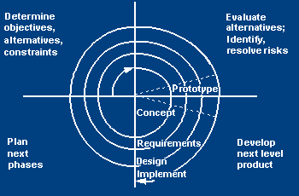
Spiral SDLC Model
Adds risk analysis, and RAD prototyping to the waterfall model
Each cycle involves the same sequence of steps as the waterfall process model

Slide 36
Spiral Quadrant
Determine objectives, alternatives and constraints
Objectives: functionality, performance, hardware/software interface, critical success factors, etc.
Alternatives: build, reuse, buy, sub-contract, etc.
Constraints: cost, schedule, interface, etc.

Slide 37
Spiral Quadrant
Evaluate alternatives, identify and resolve risks
Study alternatives relative to objectives and constraints
Identify risks (lack of experience, new technology, tight schedules, poor process, etc.
Resolve risks (evaluate if money could be lost by continuing system development

Slide 38
Spiral Quadrant
Develop next-level product
Typical activites:
  Create a design
  Review design
  Develop code
  Inspect code
  Test product

Slide 39
Spiral Quadrant
Plan next phase
Typical activities
  Develop project plan
  Develop configuration management plan
  Develop a test plan
  Develop an installation plan

Slide 40
Spiral Model Strengths
Provides early indication of insurmountable risks, without much cost
Users see the system early because of rapid prototyping tools
Critical high-risk functions are developed first
The design does not have to be perfect
Users can be closely tied to all lifecycle steps
Early and frequent feedback from users
Cumulative costs assessed frequently

Slide 41
Spiral Model Weaknesses
Time spent for evaluating risks too large for small or low-risk projects
Time spent planning, resetting objectives, doing risk analysis and prototyping may be excessive
The model is complex
Risk assessment expertise is required
Spiral may continue indefinitely
Developers must be reassigned during non-development phase activities
May be hard to define objective, verifiable milestones that indicate readiness to proceed through the next iteration

Slide 42
When to use Spiral Model
When creation of a prototype is appropriate
When costs and risk evaluation is important
For medium to high-risk projects
Long-term project commitment unwise because of potential changes to economic priorities
Users are unsure of their needs
Requirements are complex
New product line
Significant changes are expected (research and exploration)

Slide 43
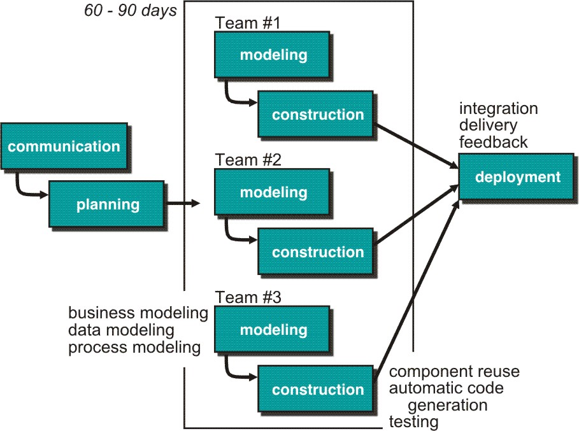
Rapid Application Development (RAD) Model
Makes heavy use of reusable software components with an extremely short development cycle

Slide 44
RAD model
Communication – to understand business problem.
Planning – multiple s/w teams works in parallel on diff. system.
Modeling –
  Business modeling – Information flow among business is working.
  Ex. What kind of information drives?
  Who is going to generate information?
  From where information comes and goes?
  Data modeling – Information refine into set of data objects that are needed to support business.
  Process modeling – Data object transforms to information flow necessary to implement business.

Slide 45
RAD Model
Construction – it highlighting the use of pre-existing software component.
Deployment – Deliver to customer basis for subsequent iteration.
RAD model emphasize a short development cycle.
“High speed” edition of linear sequential model.
If requirement are well understood and project scope is constrained then it enable development team to create “ fully functional system” within a very short time period.

Slide 46
RAD Strengths
Reduced cycle time and improved productivity with fewer people means lower costs
Time-box approach mitigates cost and schedule risk
Customer involved throughout the complete cycle minimizes risk of not achieving customer satisfaction and business needs
Focus moves from documentation to code.
Uses modeling concepts to capture information about business, data, and processes.

Slide 47
RAD Weaknesses
Accelerated development process must give quick responses to the user
Risk of never achieving closure
Hard to use with legacy systems
Requires Sufficient human resources
Requires a system that can be modularized
Developers and customers must be committed to rapid-fire activities in an abbreviated time frame.
Not appropriate when technical risks are high ( heavy use of new technology)

Slide 48
When to use RAD
Reasonably well-known requirements
User involved throughout the life cycle
Project can be time-boxed
Functionality delivered in increments
High performance not required
Low technical risks
System can be modularized

Slide 49
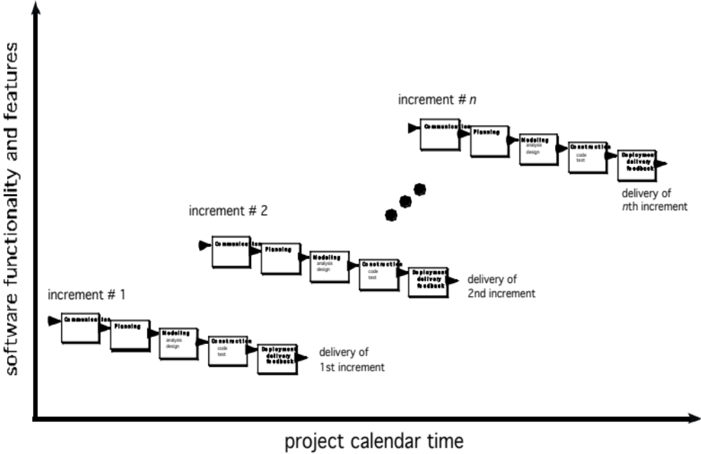
The Incremental Model

Slide 50
Incremental delivery
Rather than deliver the system as a single delivery, the development and delivery is broken down into increments with each increment delivering part of the required functionality.
User requirements are prioritised and the highest priority requirements are included in early increments.
Once the development of an increment is started, the requirements are frozen though requirements for later increments can continue to evolve.

Slide 51
Incremental Model Strengths
Develop high-risk or major functions first
Each release delivers an operational product
Customer can respond to each build
Uses “divide and conquer” breakdown of tasks
Lowers initial delivery cost
Initial product delivery is faster
Customers get important functionality early
Risk of changing requirements is reduced

Slide 52
Incremental Model Weaknesses
Requires good planning and design
Requires early definition of a complete and fully functional system to allow for the definition of increments
Well-defined module interfaces are required (some will be developed long before others)
Total cost of the complete system is not lower

Slide 53
When to use the Incremental Model
Risk, funding, schedule, program complexity, or need for early realization of benefits.
Most of the requirements are known up-front but are expected to evolve over time
A need to get basic functionality to the market early
On projects which have lengthy development schedules
On a project with new technology

Slide 54
Incremental development advantages
Customer value can be delivered with each increment so system functionality is available earlier.
Early increments act as a prototype to help elicit requirements for later increments.
Lower risk of overall project failure.
The highest priority system services tend to receive the most testing.

Slide 55
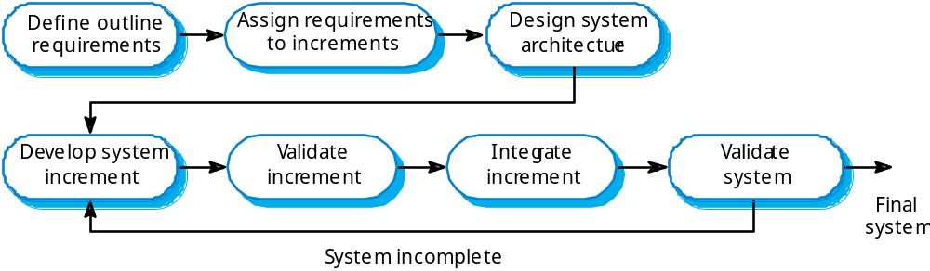
Incremental development

Slide 56
Concurrent Model
Allow a software team to represent iterative and concurrent elements of any of the process models. For example, the modeling activity defined for the spiral model is accomplished by invoking one or more of the following actions: prototyping, analysis and design.
The Figure shows modeling may be in any one of the states at any given time. For example, communication activity has completed its first iteration and in the awaiting changes state. The modeling activity was in inactive state, now makes a transition into the under development state. If customer indicates changes in requirements, the modeling activity moves from the under development state into the awaiting changes state.
Concurrent modeling is applicable to all types of software development and provides an accurate picture of the current state of a project. Rather than confining software engineering activities, actions and tasks to a sequence of events, it defines a process network. Each activity, action or task on the network exists simultaneously with other activities, actions or tasks. Events generated at one point trigger transitions among the states.

Slide 57
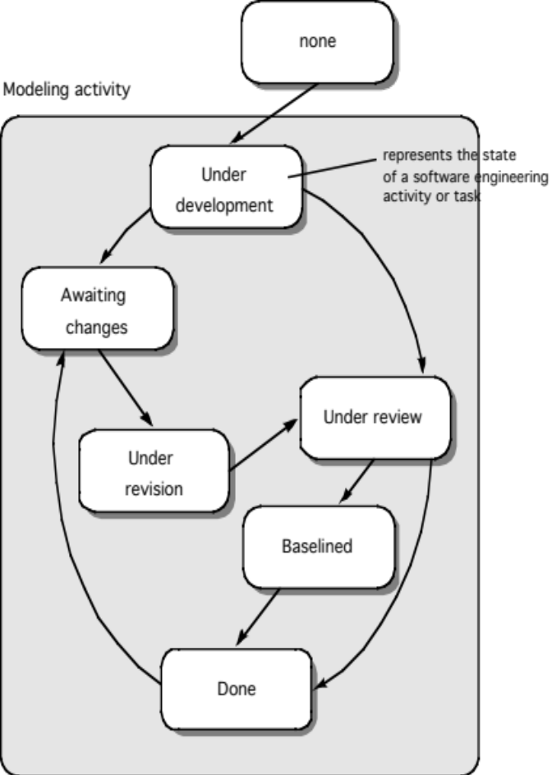
Concurrent Model

Slide 58
Still Other Process Models
Component based development—the process to apply when reuse is a development objective ( like spiral model)
Formal methods—emphasizes the mathematical specification of requirements ( easy to discover and eliminate ambiguity, incompleteness and inconsistency)
Aspect Oriented software development (AOSD)—provides a process and methodological approach for defining, specifying, designing, and constructing aspects
Unified Process—a “use-case driven, architecture-centric, iterative and incremental” software process closely aligned with the Unified Modeling Language (UML) to model and develop object-oriented system iteratively and incrementally.

Slide 59

The Unified Process (UP)
elaboration
inception

Slide 60
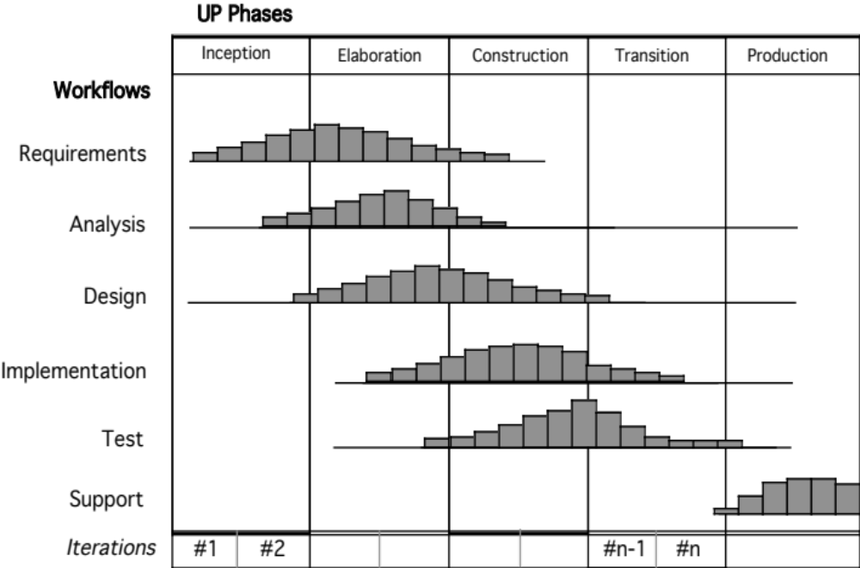
UP Phases

Slide 61
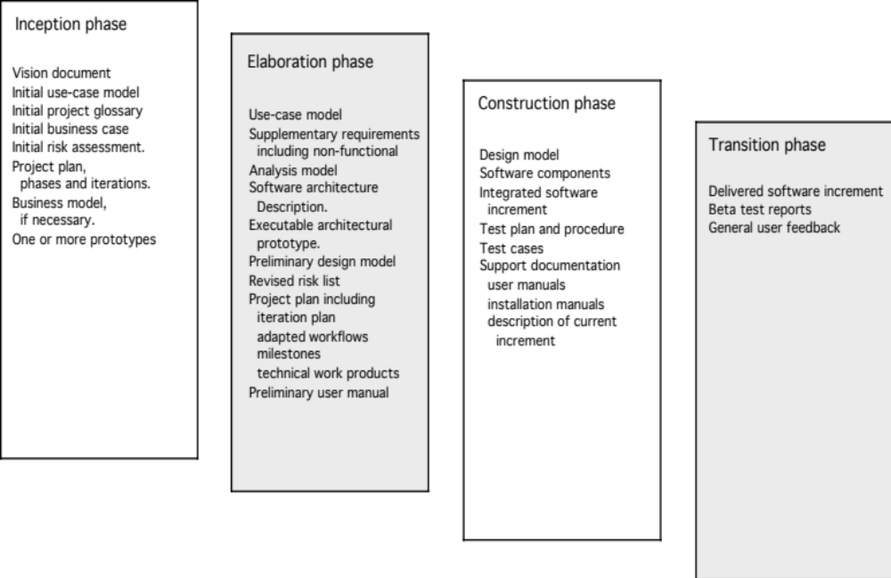
UP Work Products

Slide 62
Personal Software Process (PSP)
Planning. This activity isolates requirements and develops both size and resource estimates. In addition, a defect estimate (the number of defects projected for the work) is made. All metrics are recorded on worksheets or templates. Finally, development tasks are identified and a project schedule is created.
High-level design. External specifications for each component to be constructed are developed and a component design is created. Prototypes are built when uncertainty exists. All issues are recorded and tracked.
High-level design review. Formal verification methods (Chapter 21) are applied to uncover errors in the design. Metrics are maintained for all important tasks and work results.
Development. The component level design is refined and reviewed. Code is generated, reviewed, compiled, and tested. Metrics are maintained for all important tasks and work results.
Postmortem. Using the measures and metrics collected (this is a substantial amount of data that should be analyzed statistically), the effectiveness of the process is determined. Measures and metrics should provide guidance for modifying the process to improve its effectiveness.

Slide 63
Team Software Process (TSP)
Build self-directed teams that plan and track their work, establish goals, and own their processes and plans. These can be pure software teams or integrated product teams (IPT) of three to about 20 engineers.
Show managers how to coach and motivate their teams and how to help them sustain peak performance.
Accelerate software process improvement by making CMM Level 5 behavior normal and expected.
  The Capability Maturity Model (CMM), a measure of the effectiveness of a software process, is discussed in Chapter 30.
Provide improvement guidance to high-maturity organizations.
Facilitate university teaching of industrial-grade team skills.

Slide 64
Extreme programming
An approach to development based on the development and delivery of very small increments of functionality.
Relies on constant code improvement, user involvement in the development team and pairwise programming.
Covered in Chapter 17

